Slide 1
Software Engineering MY Private Vaccine: A Web Based Private Covid-19 Vaccination System
By:
Ni Putu Zara Athifa Wijana (E1800193)
Muthia Kartika Putri (E1800189)
Notes:
jsjsjsjsjsj

Slide 2
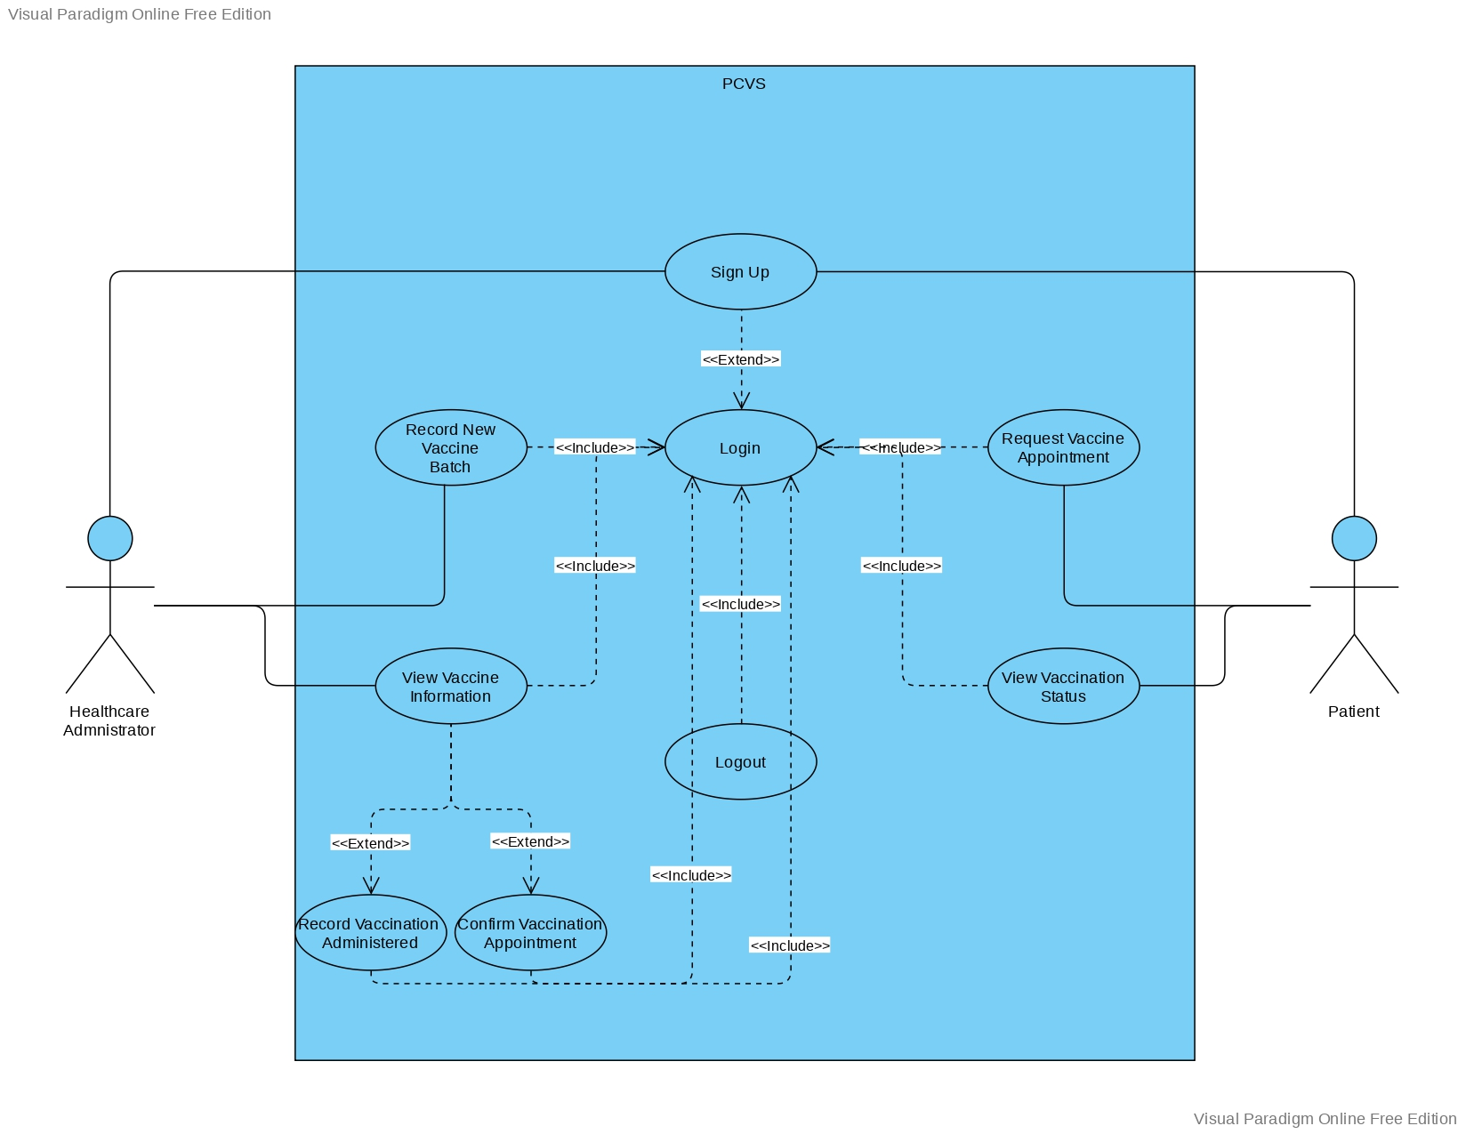
Use Case Diagram

Slide 3
Division of Work
Iteration 1
No. | Use Case | Develop by
1. | Sign Up | Ni Putu Zara Athifa Wijana
2. | Login | Ni Putu Zara Athifa Wijana
3. | Logout | Ni Putu Zara Athifa Wijana

Slide 4
Division of Work
Iteration 2
No. | Use Case | Develop by
1. | Request vaccine appointment | Ni Putu Zara Athifa Wijana
2. | Record new vaccine batch | Ni Putu Zara Athifa Wijana
3. | View vaccine information | Muthia Kartika Putri
4. | Record vaccination administered | Muthia Kartika Putri
5. | Confirm vaccination appointment | Muthia Kartika Putri

Slide 5
Live Demonstration

Slide 6
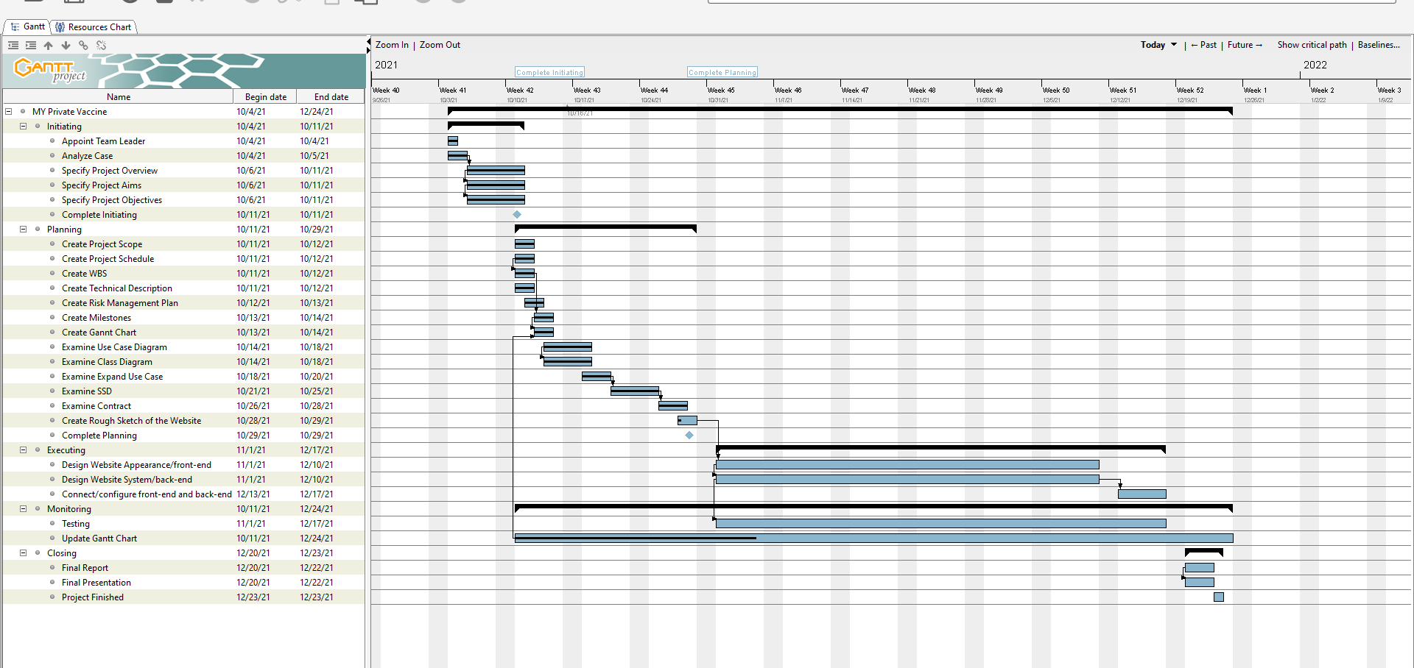
Gantt Chart (before)

Slide 7
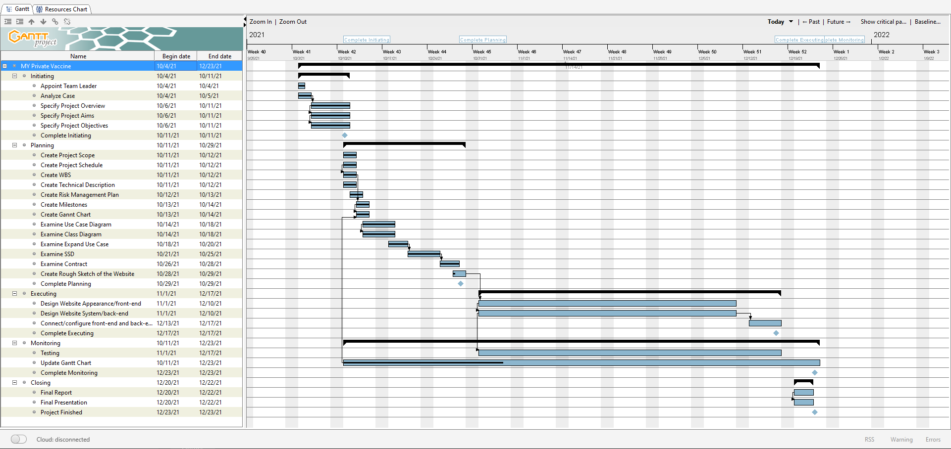
Gantt Chart (after)

Slide 8
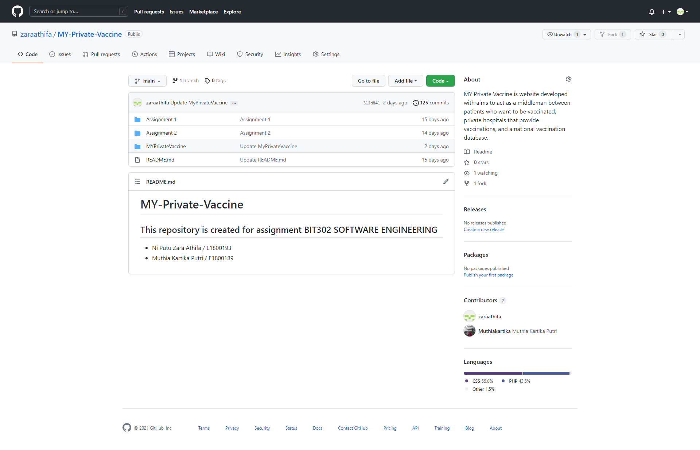
Git Hub

Slide 9
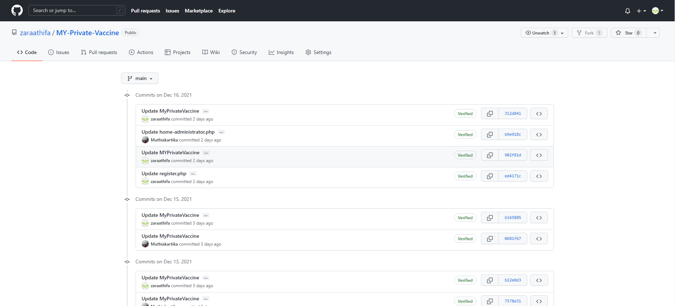
Git Hub

Slide 10
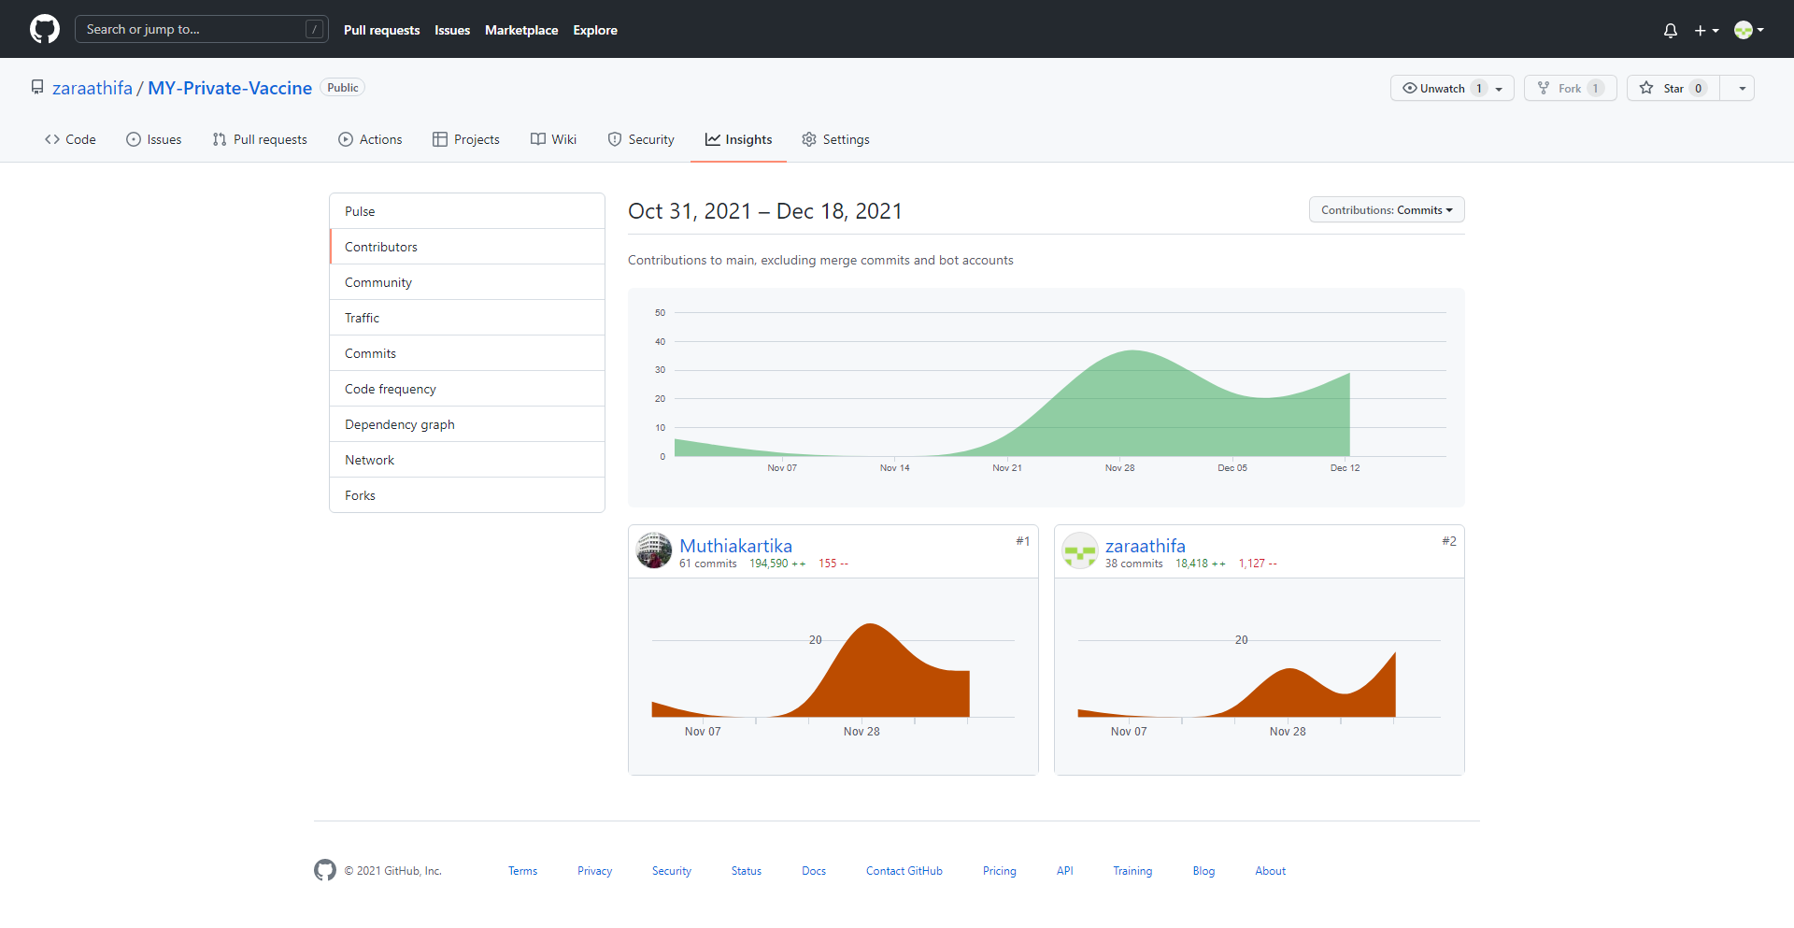
Git Hub

Slide 11
Thank You

